Slide 1


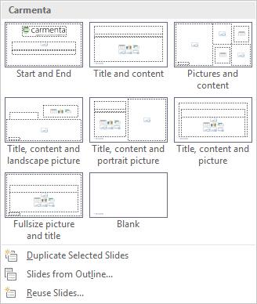
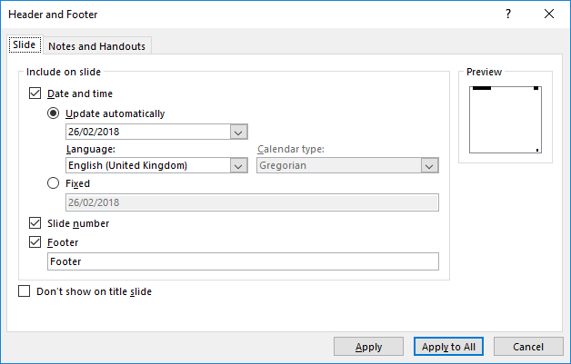

Instructions Hidden page and will not show in print
Click on the button New Slide for different choices of layouts.
Click on the button Layout to change layout on a existing page.
Click on the button Reset to restore the look on the page to the original layout according to the template.
Please make sure that the objects and text are placed within the pages guides. To show guides go to View and checkmark Guides (or press Alt + F9).
Colors: to add colors to objects use the framed colors that follows your graphical design.
To add or remove header and footer go to the Insert tab and select Header & footer. Change in the dialogue and the click on Apply to all.
Don’t use Standard colours!

Slide 2




Instructions Hidden page and will not show in print
To change format and use bullets do not use this functions!
To change format and/or to use bullets, change the level here.
If the file size is to large, choose picture and use Compress Pictures.
Choose resolution.
To import slides from another presentation with another template, use New Slide/Reuse Slides.
Browse to the chosen presentation, and mark the slide(s) you want to reuse.
If you want to do this on all pictures, click out the box for Apply only to this picture.
Please note that compressing pictures can’t be undone. If you change your mind, you need to replace the pictures.
Don’t use Keep source formatting. If you do, the slides will be imported with the old format.

Slide 3
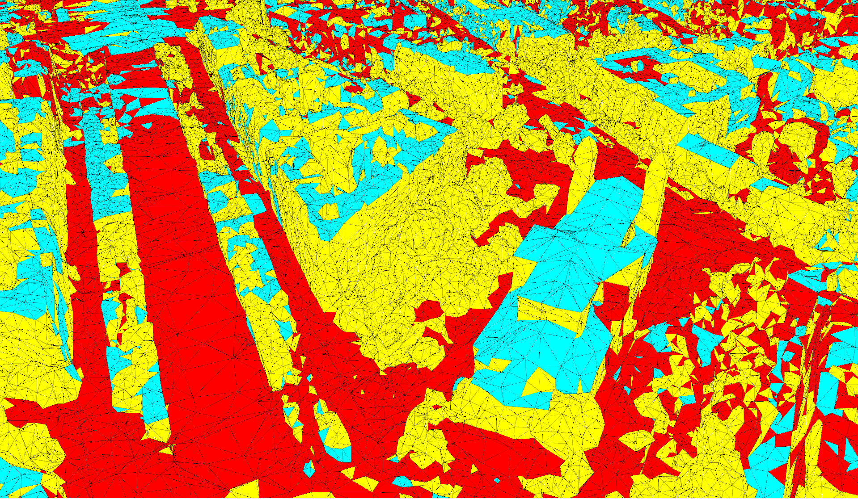
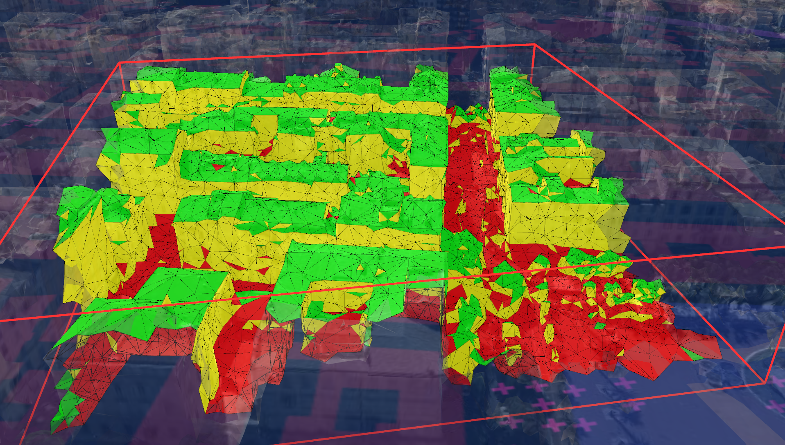
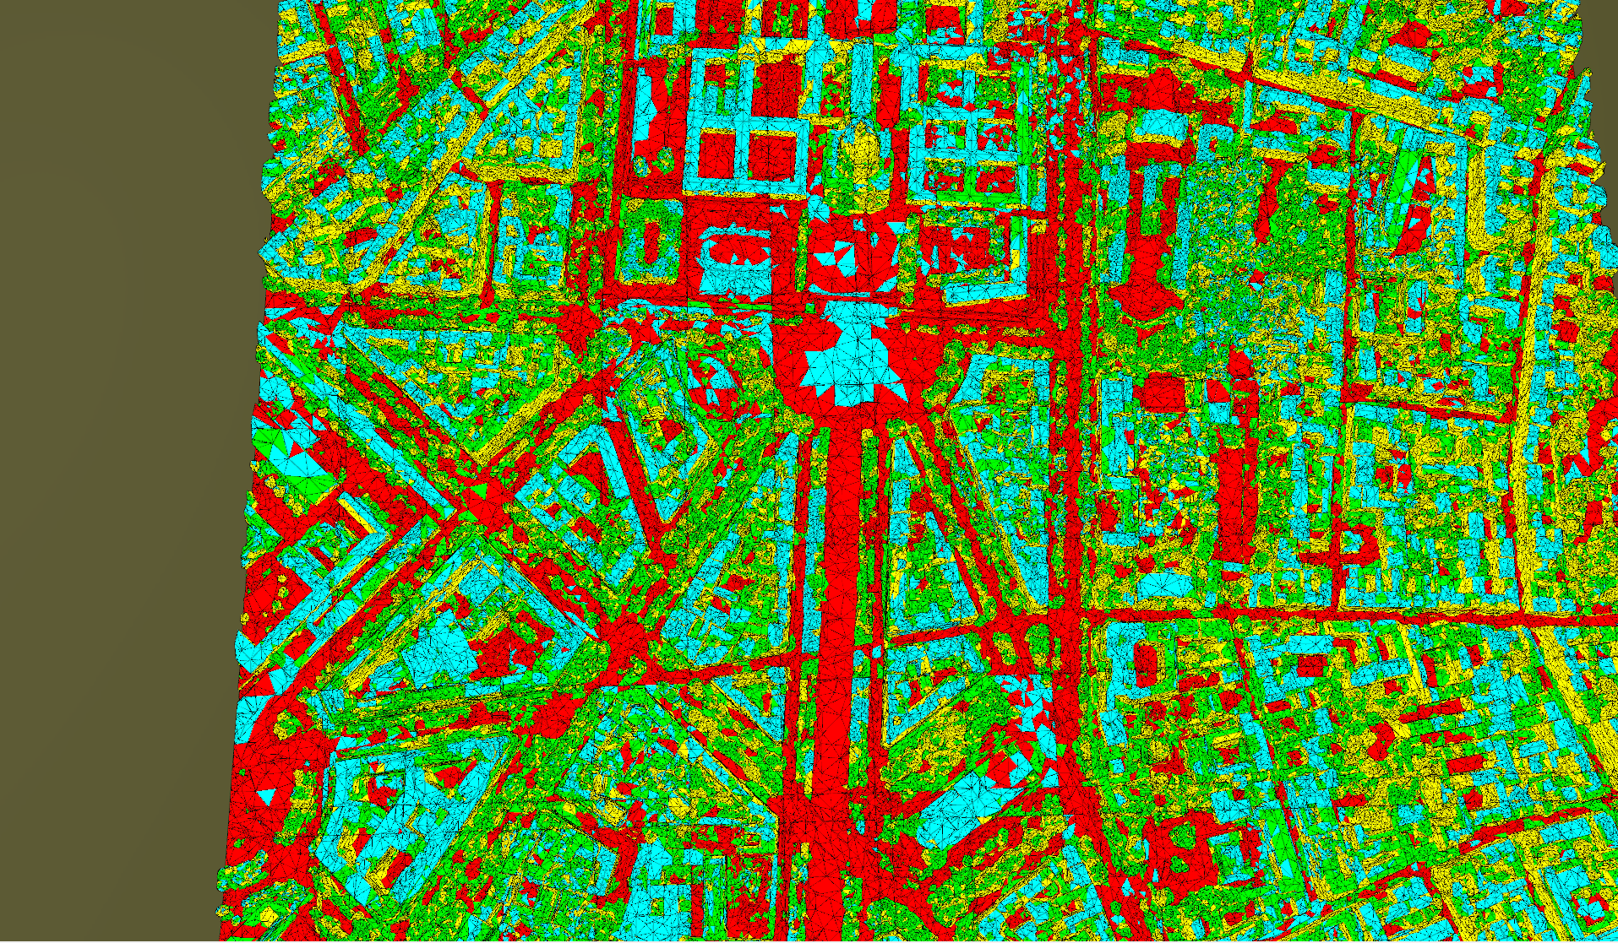
Results
Trouver une belle maniere de presenter
Sinon demo

Slide 4
Object identification in 3D urban meshes
Olivier Marion

Slide 5
Outline:
Background
Motivation
Machine learning overview
Urban model analysis
Object identification pipeline
Input
Preprocessing
Primary clustering
Postprocessing
Object detection & identification
Conclusion

Slide 6
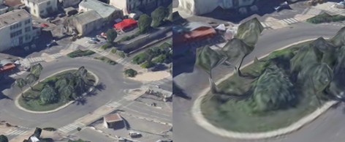
Motivation
Meshes quality improvement
More faithful to reality
Avoids extra computations
Greater understanding of the model from the program point of view
Applications of 3D models:
Urban planning, itinerary planning, accessibility analysis for different types of mobility,
Emergency response simulation,
Virtual tourism and cultural heritage documentation, etc.

Slide 7
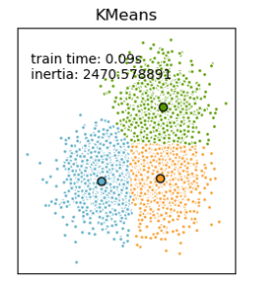
Machine Learning overview
Used for data analysis and in AI
Infer relations, patterns, models from “training data”
Input data: features concatenated into a representation vector
Output: either discrete (classification) or continuous (regression)
Supervised learning: training data includes inputs and outputs
Unsupervised learning: training data only includes inputs
Clustering: unsupervised learning
k-means: form clusters based on Euclidean distance in representation space
k-means clustering
Source: scikit-learn.org

Slide 8
Urban model analysis literature
Frequently performed for urban modelling
Input data
Elevation laser scans in association with aerial pictures
Multi-view stereo images
Mesh usually corresponds to the output data
Urban mesh analysis literature is very marginal
Even more so for unsupervised approaches
Usually high-resolution meshes as input
Notes:
To give an idea,
The input mesh for test in ther papers consists in 300m per 300m area from Paris. It is represented by 1million triangles and two textures maps of 8192x8192 pixels.
Equivalent of this in our Paris collada dataset is around 100k triangles, so about ten times lower

Slide 9
Object identification pipeline
Inspiration from object detection and identification pipeline in 3D point clouds
Input: 3D mesh
Output: 3D meshes
Preprocessing
Primary clustering
Ground model generation
Object detection
Segmenting individual objects from the ground mesh
Object classification
Labelling each individual object
Postprocessing
Watershed
from local maxima in the ground mesh
k-means clustering
SVM classification
Labeled training set
Ground mesh detection
elevation image
Semantic mesh segmentation
{Ground, roof, façade, tree}-clustering
Implemented
Only suggested

Slide 10
Object identification pipeline
Inspiration from object detection and identification pipeline in 3D point clouds
Input: 3D mesh
Output: 3D meshes
Preprocessing
Primary clustering
Ground model generation
Object detection
Segmenting individual objects from the ground mesh
Object classification
Labelling each individual object
Postprocessing
Watershed
from local maxima in the ground mesh
k-means clustering
SVM classification
Labeled training set
Ground mesh detection
elevation image
Semantic mesh segmentation
{Ground, roof, façade, tree}-clustering
Implemented
Only suggested

Slide 11
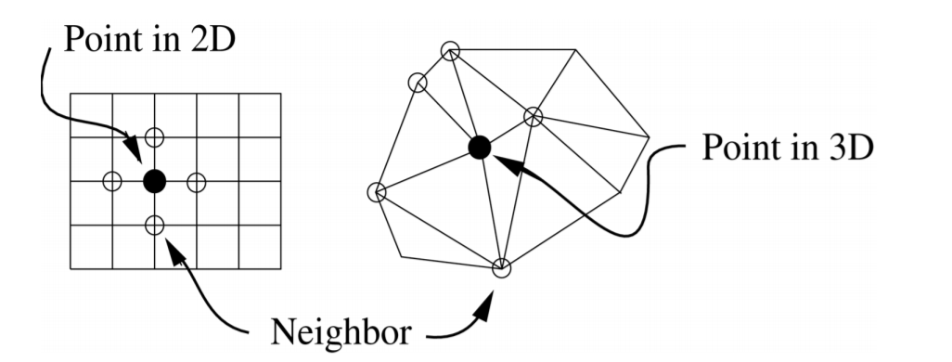
Input
3D mesh:
set of vertex positions
set of triangles defined by an ordered list of vertex indices
associated texture images and corresponding vertex mappings
No ground-truth or accurate enough reference data
Vertex/triangle structures do not have neighbors
Vertices neighbors, connected by an edge
Triangles neighbors, sharing an edge
Coordinates:
Conversion to local metric XYZ coordinate system to avoid numerical errors
Neighbors in 2D and 3D, (Mangan et al., 1999)

Slide 12
Object identification pipeline
Inspiration from object detection and identification pipeline in 3D point clouds
Input: 3D mesh
Output: 3D meshes
Preprocessing
Primary clustering
Ground model generation
Object detection
Segmenting individual objects from the ground mesh
Object classification
Labelling each individual object
Postprocessing
Watershed
from local maxima in the ground mesh
k-means clustering
SVM classification
Labeled training set
Ground mesh detection
elevation image
Semantic mesh segmentation
{Ground, roof, façade, tree}-clustering
Implemented
Only suggested

Slide 13
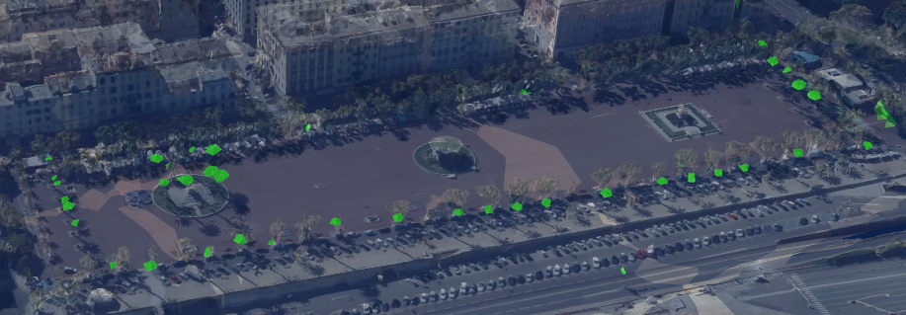
Preprocessing
Connectivity analysis
Look for small disconnected clusters, in terms of number of triangles
Division of the input mesh into submeshes
Mapping neighbors: memory/time tradeoff
Superfacet partitioning within a submesh:
Grouping triangles via similarity in shape operator, color, alignment of normal, etc.
2.15 triangles in average per superfacet in a low resolution mesh
Connectivity analysis results
Notes:
Set of computations performed at the beginning:
Ensures consistency for information extraction
Operations requiring the whole mesh
Connectivity analysis:
Look into the mesh from a purely geometrical pov
Only effective in lower-quality meshes
Not all disconnected components are artefacts
Can be used in a training set for object classification
Lower resolution leads to larger triangles and sharper angles

Slide 14
Object identification pipeline
Inspiration from object detection and identification pipeline in 3D point clouds
Input: 3D mesh
Output: 3D meshes
Preprocessing
Primary clustering
Ground model generation
Object detection
Segmenting individual objects from the ground mesh
Object classification
Labelling each individual object
Postprocessing
Watershed
from local maxima in the ground mesh
k-means clustering
SVM classification
Labeled training set
Ground mesh detection
elevation image
Semantic mesh segmentation
{Ground, roof, façade, tree}-clustering
Implemented
Only suggested

Slide 15
Primary clustering
Two approaches
Need relevant features to capture geometrical information from the mesh
Elevation image and image morphology
Used on 3D point clouds
Mostly uses a 2.5D representation of the data, hence compatible with meshes in theory
Unsupervised detection
Mesh segmentation
Used on meshes
Performed on high-resolution meshes
Superior results with supervised approaches
Notes:
Critical step in the whole pipeline, as it gives the ground to segment the objects from or some semantics isolating trees

Slide 16
Feature extraction
Elevation
Function of the relative height (z-coordinate) of a point
Discriminates ground from higher objects such as roofs
Planarity
Measures how “flat” a superfacet/triangle is
Should discriminate vegetation from the rest
Horizontality
Cosine of the angle between the normal of the superfacet/triangle and the vertical axis
Discriminates vertical components such as facades
Notes:
These features are found in previous works.
Should as trees in previous unsupervised approaches are often mislabelled as facades + roof
-> planarity not enough

Slide 17
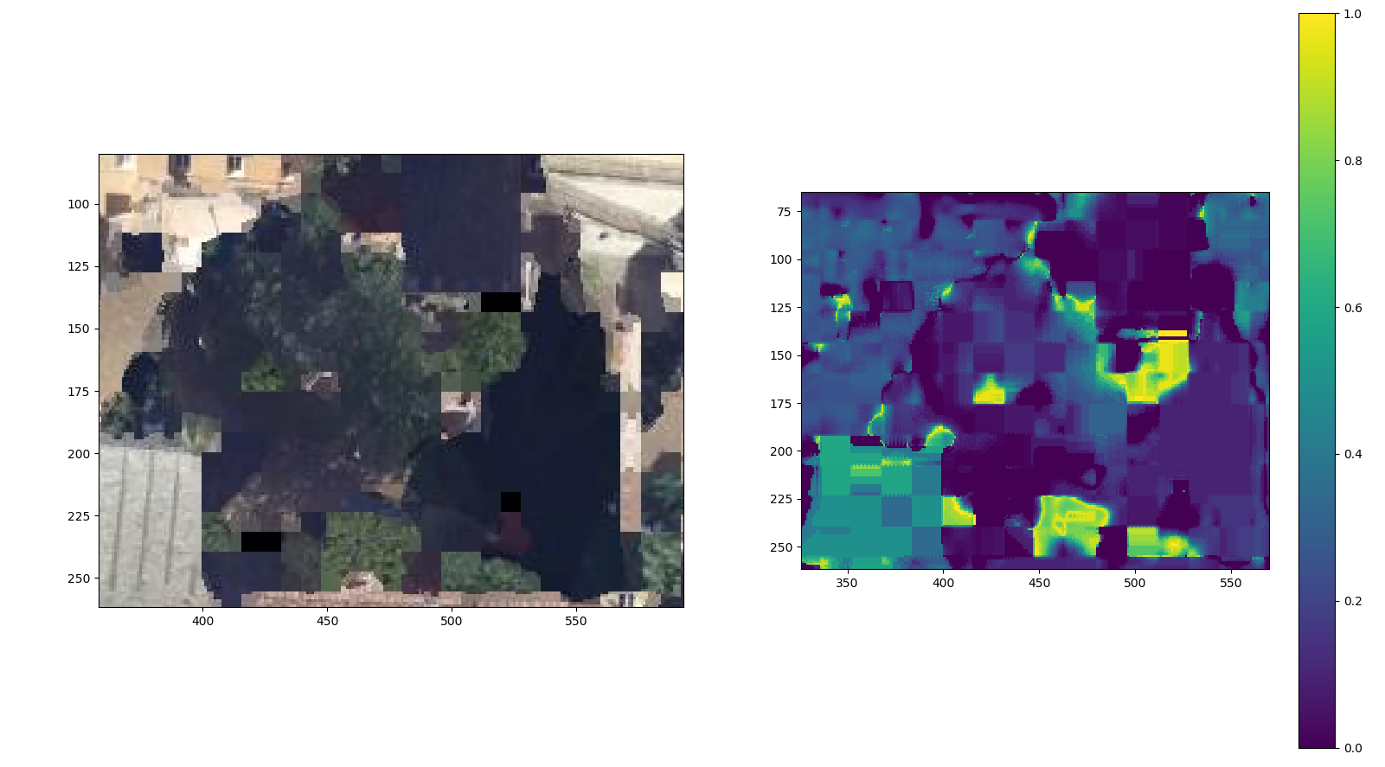
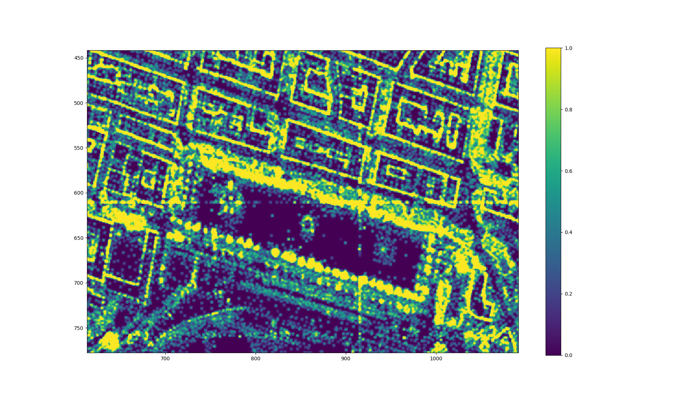
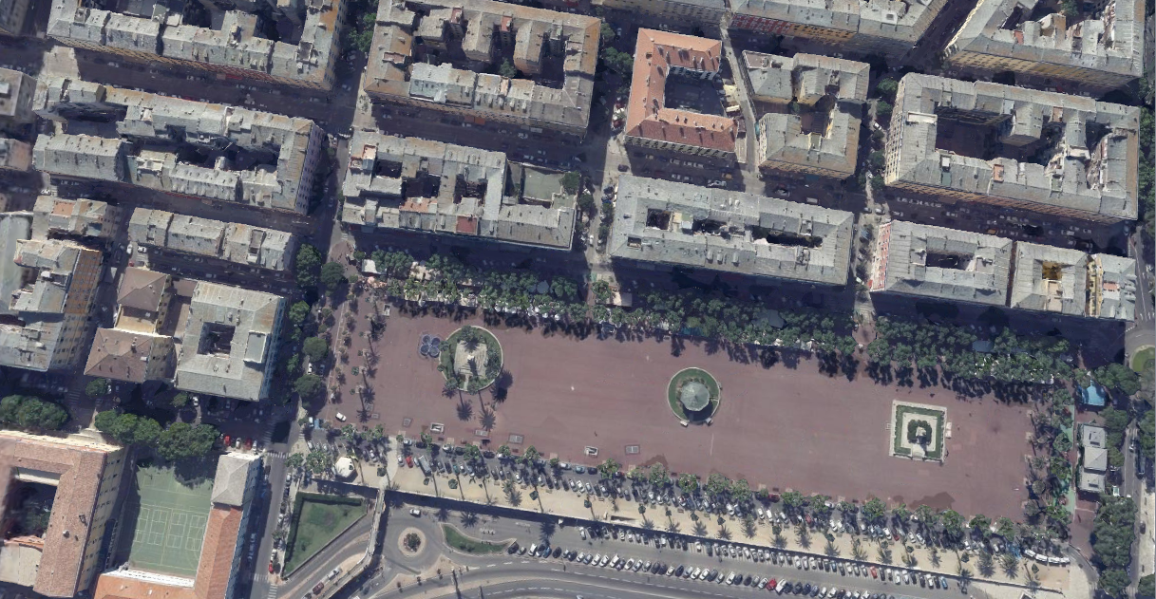
Feature extraction (2)
Greenness
Intuitively, humans can discriminate trees based on textures
Computed based on hue value in Hue Saturation Value color space
Density
Mesh are sparse representations: complicated objects → more triangles
Greenness feature on texture close-up
Density feature
Notes:
I designed these features to adapt to the problem
Might it be across this study or literature, unsupervised detection of trees truly represent a challenge. Some approaches overcome it using textures in supervised approaches while some geometrical properties of th mesh might be enough to detect the trees.
HSV cause H corresponds to the chromatic circle and therefore a measure of green
In the end, although it works a bit, mapped textures are often not a 100% green. Also a problem for winter....

Slide 18
Object identification pipeline
Inspiration from object detection and identification pipeline in 3D point clouds
Input: 3D mesh
Output: 3D meshes
Preprocessing
Primary clustering
Ground model generation
Object detection
Segmenting individual objects from the ground mesh
Object classification
Labelling each individual object
Postprocessing
Watershed
from local maxima in the ground mesh
k-means clustering
SVM classification
Labeled training set
Ground mesh detection
elevation image
Semantic mesh segmentation
{Ground, roof, façade, tree}-clustering
Implemented
Only suggested

Slide 19
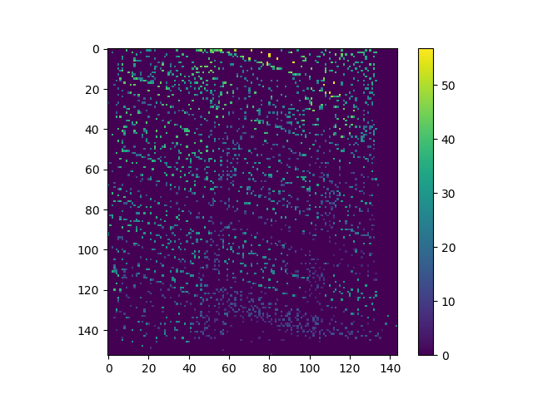
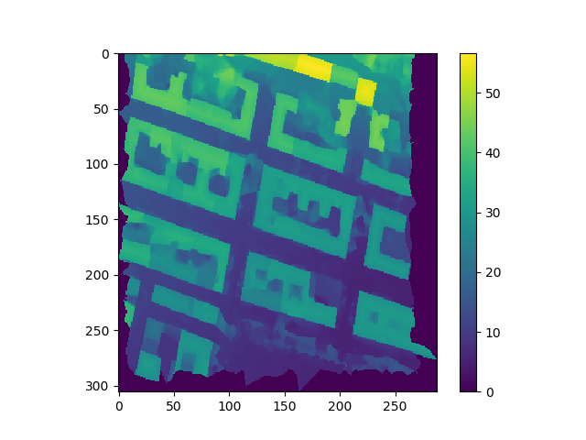
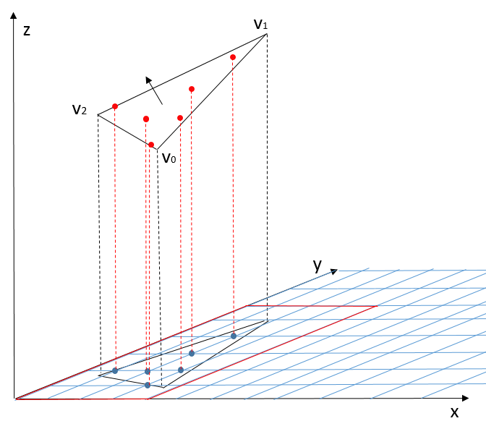
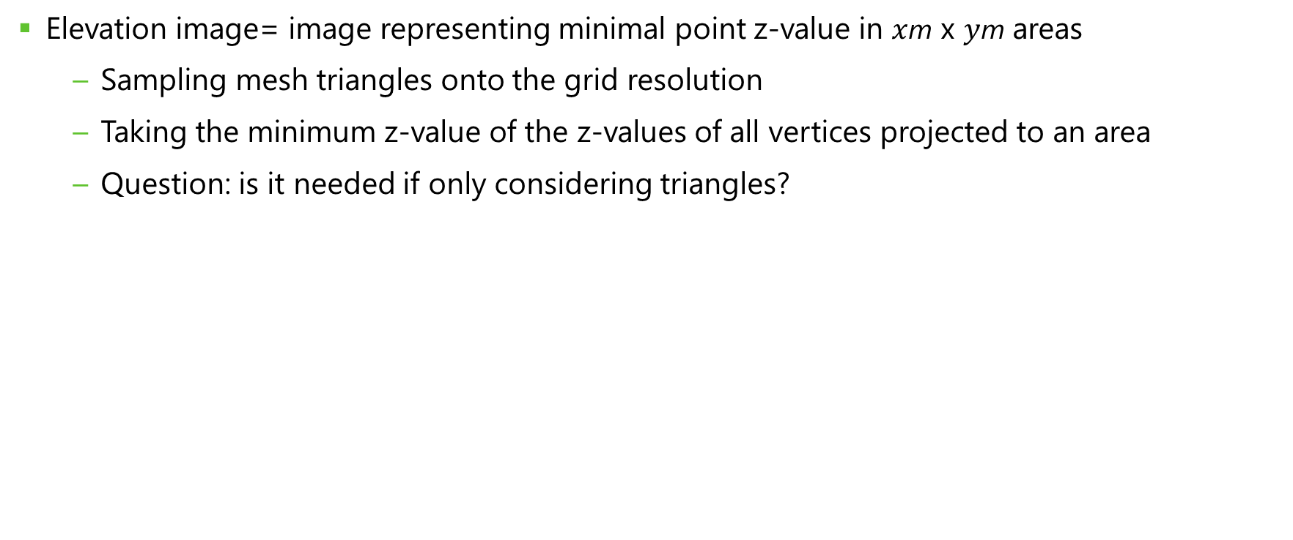
Elevation image
Elevation image= image representing minimal point z-value in $x$m x $y$m areas
Sampling mesh triangles onto the grid resolution
Taking the minimum z-value of the z-values of all vertices projected to an area
Question: is it needed if only considering triangles?
Elevation image from mesh vertices
Sampling new vertices
Elevation image from sampled vertices

Slide 20
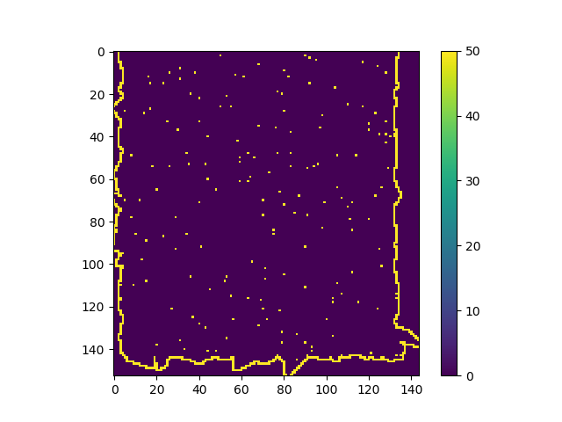
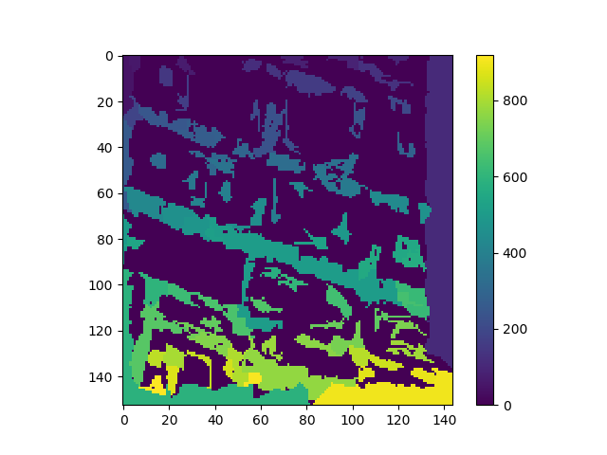
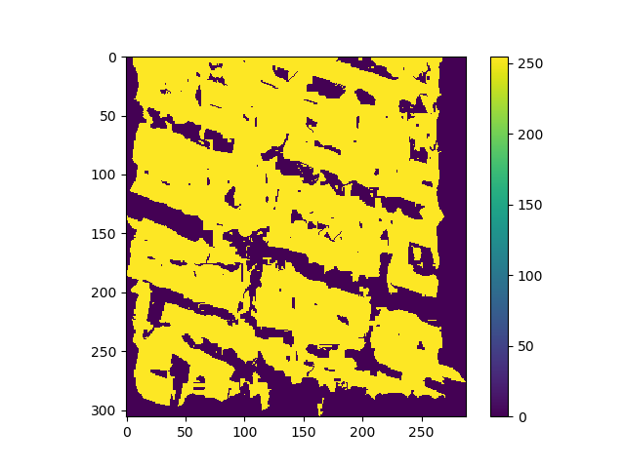
Elevation image: ground model
λ-flat zones labelling algorithm:
Two neighboring pixels belong to the same region if their value difference < λ
Ground := larger λ-flat zone
Problem: mesh surface information → discontinuous ground
Select only λ-flat zones containing a local minimum from the elevation picture

Slide 21
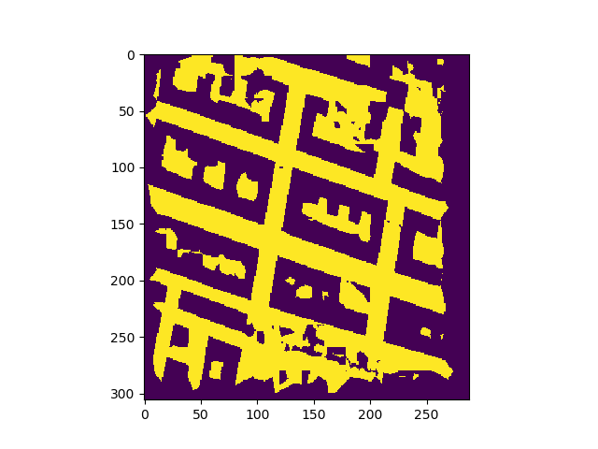
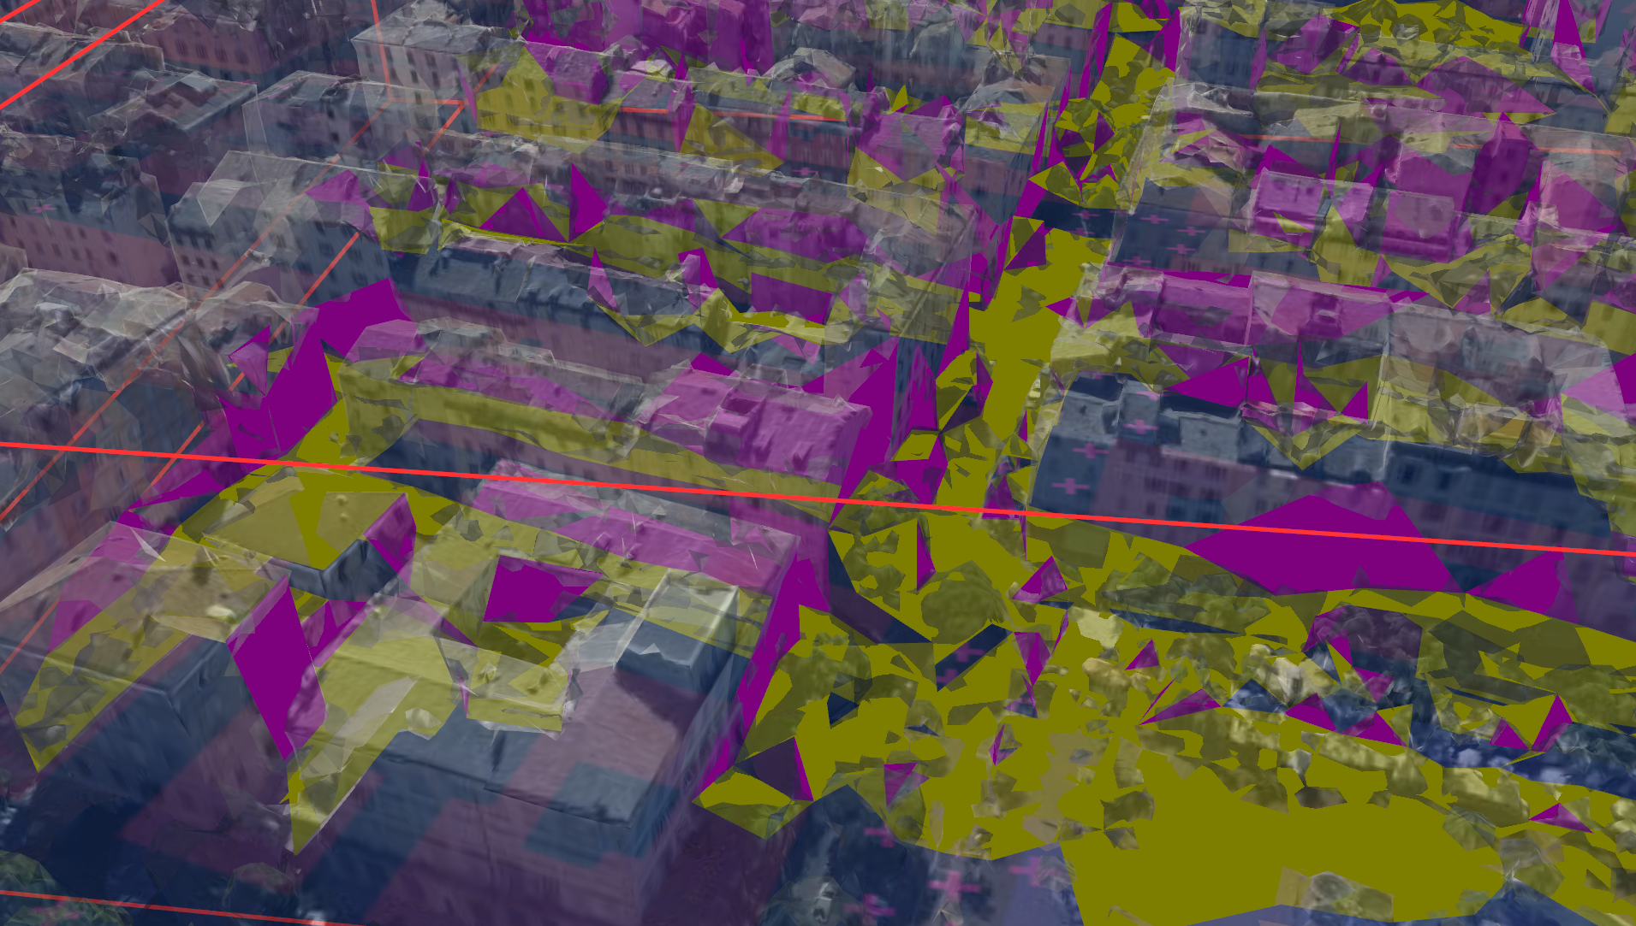
Elevation image: ground model (2)
k-means clustering on pixels
Based on scaled z-value and normal angle with z axis
Backprojection:
Triangles projected to a ground pixel are labelled as ground
However façade triangles often projected on ground pixels
Extra clustering on normal angle with z-axis
Conclusion:
Direct adaptation of a 3D point cloud technique
Holds potential
Chronological step
If using triangle-properties-based clustering, why not directly cluster triangles
Binary ground model
from image pixels clustering
(yellow: ground)
Ground model backprojection (yellow: ground)

Slide 22
Object identification pipeline
Inspiration from object detection and identification pipeline in 3D point clouds
Input: 3D mesh
Output: 3D meshes
Preprocessing
Primary clustering
Ground model generation
Object detection
Segmenting individual objects from the ground mesh
Object classification
Labelling each individual object
Postprocessing
Watershed
from local maxima in the ground mesh
k-means clustering
SVM classification
Labeled training set
Ground mesh detection
elevation image
Semantic mesh segmentation
{Ground, roof, façade, tree}-clustering
Implemented
Only suggested

Slide 23
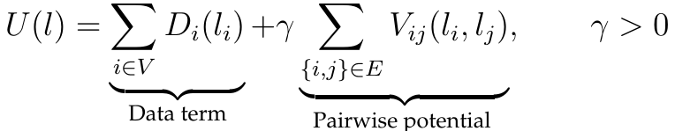
Mesh segmentation
In its simplest form: clustering problem on triangles
k-means algorithm on feature vector
Clustering taking into account spatial and context information
Markov Random Field: set of random variables with Markov property, described by undirected graph
Requires an adjacency relationship
For mesh segmentation, nodes:= triangles, edges:= edges
Equivalent to an energy minimization:
Solved with graph cuts
Notes:
Features are relevant for this part as well

Slide 24
Mesh segmentation (2)
 | k-means | MRF formulation
User input | - k: number of clusters | - γ: smoothing parameter - Data term D, pairwise potential V
Adding features | - Features must have same weight | - Need to redefine D, V to anticipate how they affect the different classes
Classes definition | - Vary from one set to another Semantic classes inferred from centers Even split of the input space Clusters depend on initialization | - Defined by D
Implementation | Easy to implement Available in Machine Learning libraries | - Different ways of solving Requires implementation

Slide 25
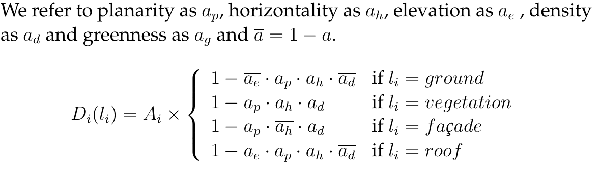
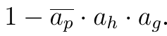
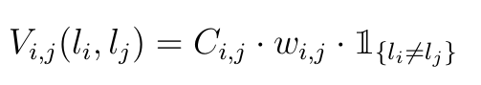
MRF formulation
Data term D: features combination weighted by area of the superfacet
Vegetation term alternative formulation:
Pairwise interaction V: favors label smoothness:
Weighted by interface edge lengths and normals angle cosine

Slide 26
Object identification pipeline
Inspiration from object detection and identification pipeline in 3D point clouds
Input: 3D mesh
Output: 3D meshes
Preprocessing
Primary clustering
Ground model generation
Object detection
Segmenting individual objects from the ground mesh
Object classification
Labelling each individual object
Postprocessing
Watershed
from local maxima in the ground mesh
k-means clustering
SVM classification
Labeled training set
Ground mesh detection
elevation image
Semantic mesh segmentation
{Ground, roof, façade, tree}-clustering
Implemented
Only suggested

Slide 27
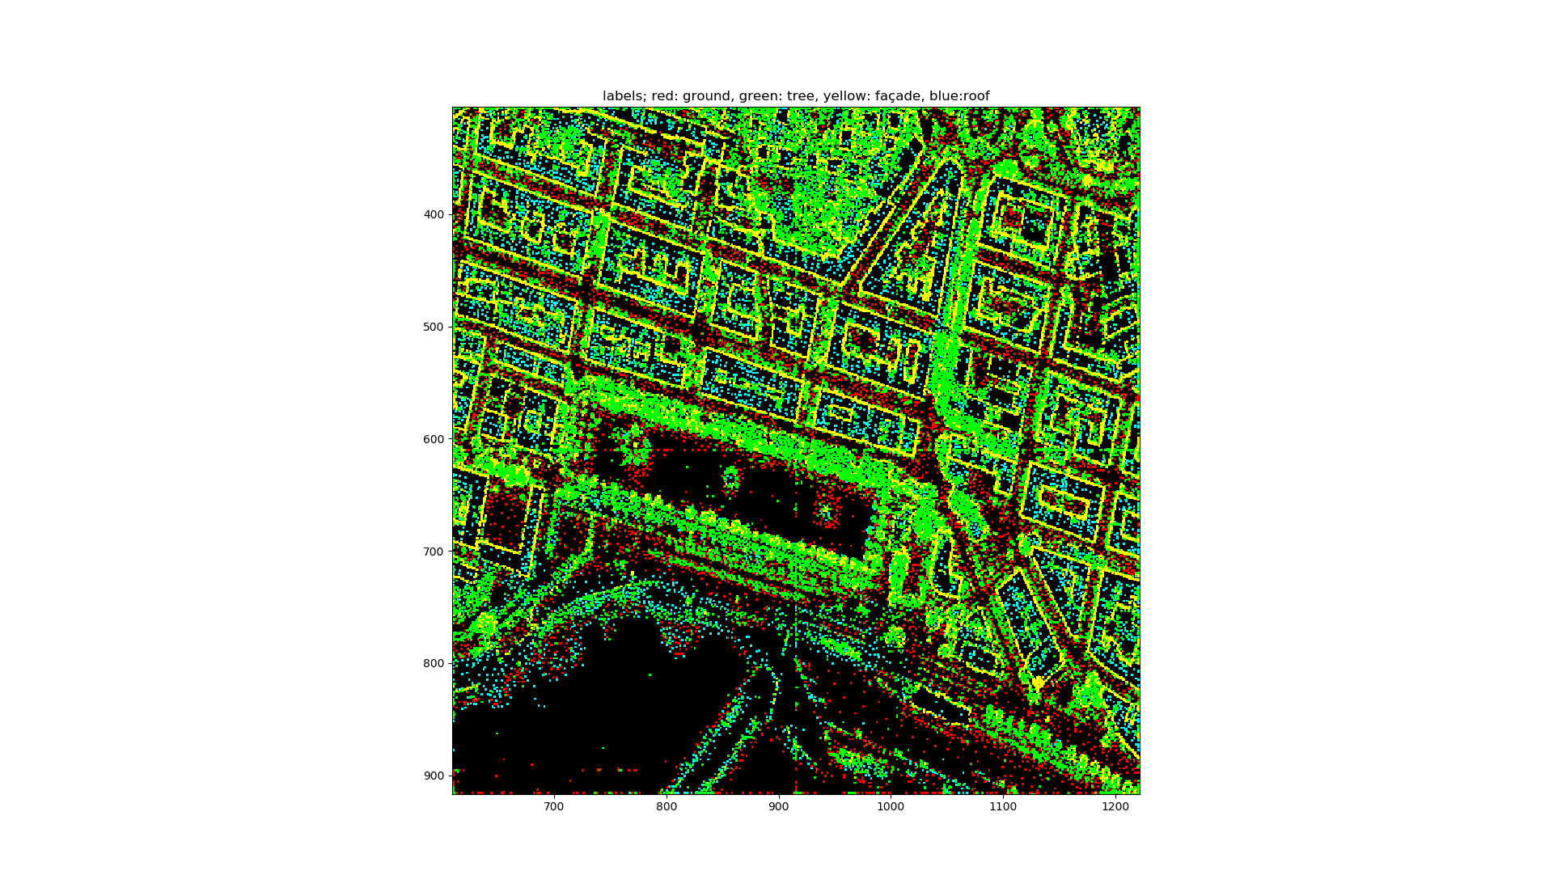
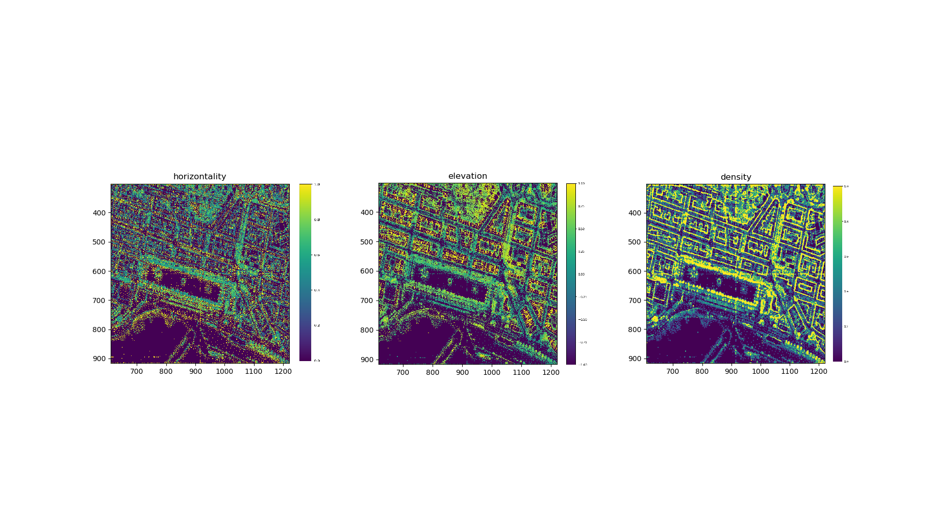
How about both?
Apply MRF formulation to image pixels
Primary results
vegetation class ~> object class
No planarity -> façade/vegetation confusion
MRF classification using 3 features and data term only

Slide 28
Primary clustering: conclusion
Mesh segmentation:
K-means and MRF results are pretty similar in best cases
Encounters similar problems as in the literature
Large ground areas will have parts misclassified as roof
Large trees mislabeled as roof/façade
Using elevation images
Requires triangle information
Obtains a 2D city representation
Need to backproject to obtain meshes for object detection
Possibility to use a classification via MRF to cluster elevation image pixels

Slide 29
Demo

Slide 30
Object identification pipeline
Inspiration from object detection and identification pipeline in 3D point clouds
Input: 3D mesh
Output: 3D meshes
Preprocessing
Primary clustering
Ground model generation
Object detection
Segmenting individual objects from the ground mesh
Object classification
Labelling each individual object
Postprocessing
Watershed
from local maxima in the ground mesh
k-means clustering
SVM classification
Labeled training set
Ground mesh detection
elevation image
Semantic mesh segmentation
{Ground, roof, façade, tree}-clustering
Implemented
Only suggested

Slide 31
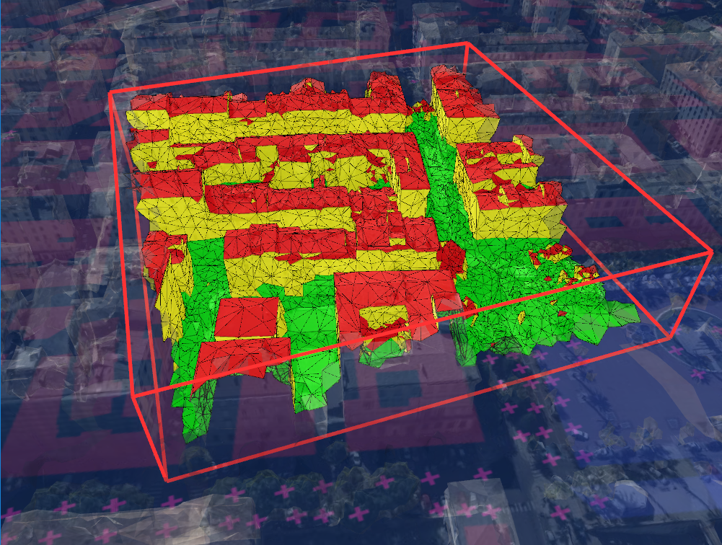
Postprocessing
Helps pally recurring errors that are easy to fix
Ensures smoothness and over-inclusive ground mesh for detection
Everything below a ground triangle is ground
If all 3 neighbors of a triangle have the same label, then the triangle also has this label
Before/after: postprocessing rules

Slide 32
Object identification pipeline
Inspiration from object detection and identification pipeline in 3D point clouds
Input: 3D mesh
Output: 3D meshes
Preprocessing
Primary clustering
Ground model generation
Object detection
Segmenting individual objects from the ground mesh
Object classification
Labelling each individual object
Postprocessing
Watershed
from local maxima in the ground mesh
k-means clustering
SVM classification
Labeled training set
Ground mesh detection
elevation image
Semantic mesh segmentation
{Ground, roof, façade, tree}-clustering
Implemented
Only suggested

Slide 33
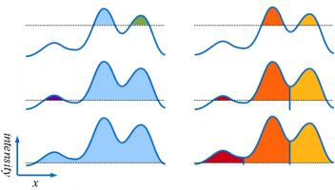
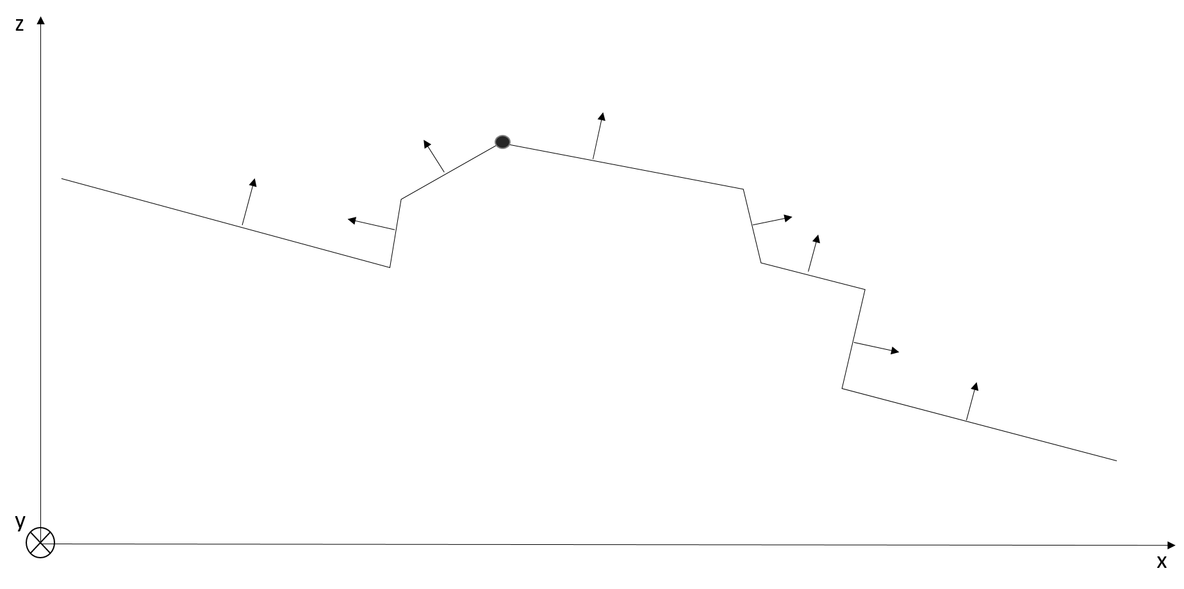
Object detection
Watershed
Regions are segmented in catchment basins
Markers: local maxima in the ground mesh
Constraints:
Can’t use sharp creases-based constraints
Based on texture
Ideally: elevation data for the ground
Watershed principle
Car on hilly road profile

Slide 34
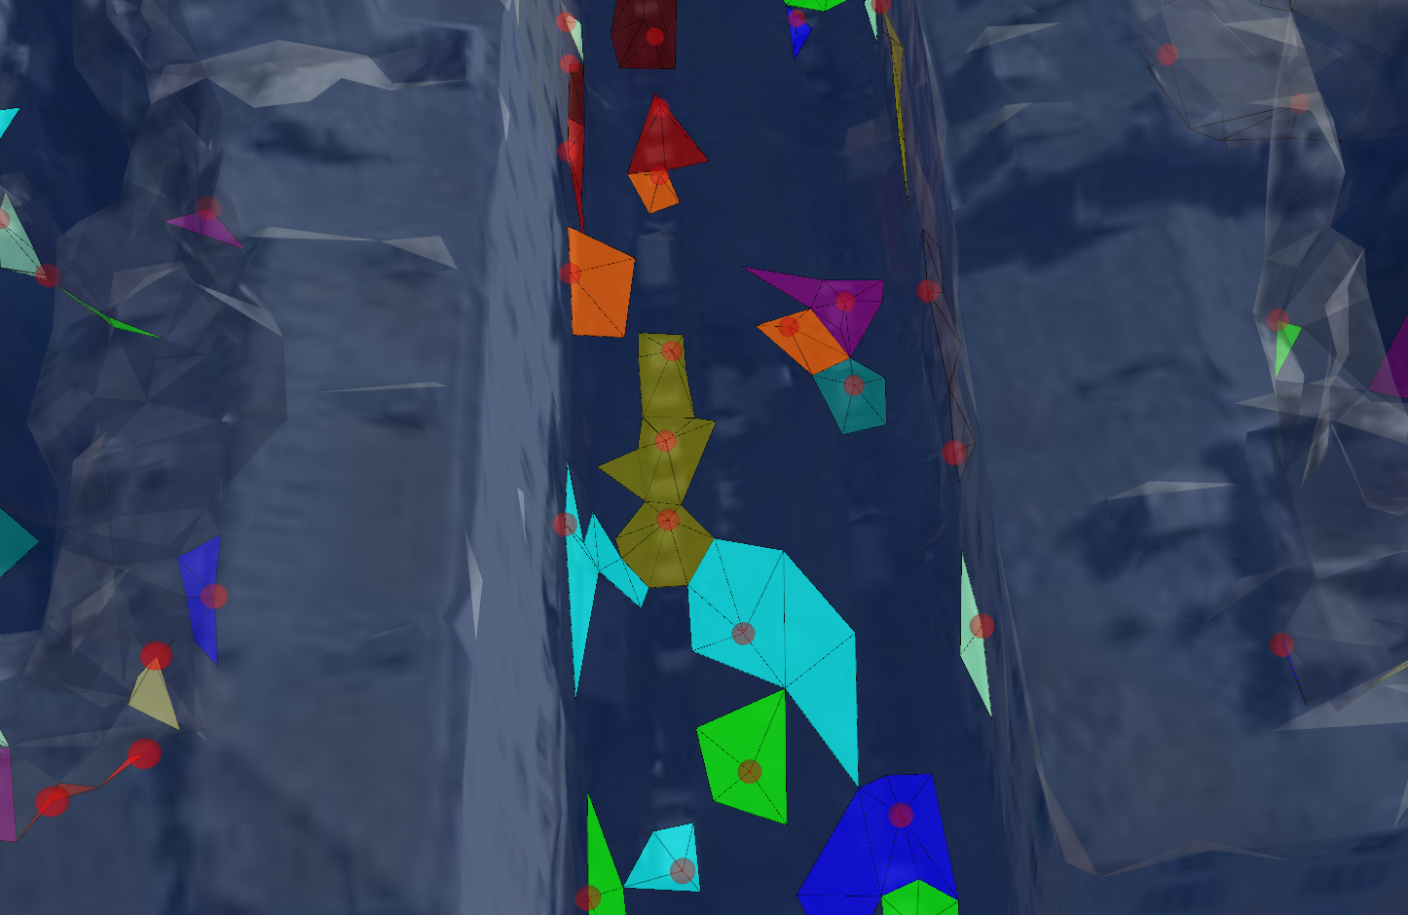
Object detection: results
Maxima marked as red spheres
Two main types of objects:
Ground objects
Misclassified façade chunks (from the borders of the ground mesh)
Object detection

Slide 35
Object identification pipeline
Inspiration from object detection and identification pipeline in 3D point clouds
Input: 3D mesh
Output: 3D meshes
Preprocessing
Primary clustering
Ground model generation
Object detection
Segmenting individual objects from the ground mesh
Object classification
Labelling each individual object
Postprocessing
Watershed
from local maxima in the ground mesh
k-means clustering
SVM classification
Labeled training set
Ground mesh detection
elevation image
Semantic mesh segmentation
{Ground, roof, façade, tree}-clustering
Implemented
Only suggested

Slide 36
Object classification
Unsupervised:
Clustering based on elevation/horizontality
Supervised:
Manually label a set of objects
Use an Support Vector Machine (SVM) classifier
SVMs generalize rather well from limited training sets

Slide 37
Conclusion
Primary clustering and ground detection:
Density: suitable feature candidate for object detection
MRF is a good clustering approach for mesh segmentation
Object detection:
Ideally, use ground elevation data to stop propagation
Object classification:
Label a set from object detection and use it to train a supervised classifier
General conclusion:
Trees identification remains a challenge
Algorithm would detect bumps or ground artefacts that could then be flattened

Slide 38
Thank you for your attention!

